Slide 1



@swardley maps FIRST AID
Wardley Mapping Crash Course
Dr Petra Vukmirovic
Notes:
Introduce yourself
Thank everyone
Great to be here
This is my little crash course on Wardley mapping
It is aimed at total begginers but could be fun for other levels
I would like to make this a discussion forum rather than me teaching you things – so if you have, questions, comments or you disagree with anything stated feel free to interrupt and lets all discuss it

Slide 2

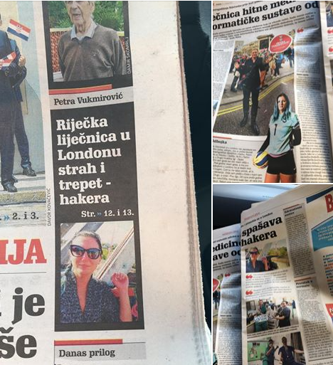

Who am i?
Glasswall InfoSec Team
Productivity Engineer
Rookie Medium Blogger
https://medium.com/@pvukmirovic
Python student and enthusiast
DevSecOps enthusiast
“Doctor from Rijeka in London – the fear of every hacker ☺”
Notes:
Talk about your interview
Then phoenix project – blog and devsecops
Python – recent boto3….

Slide 3

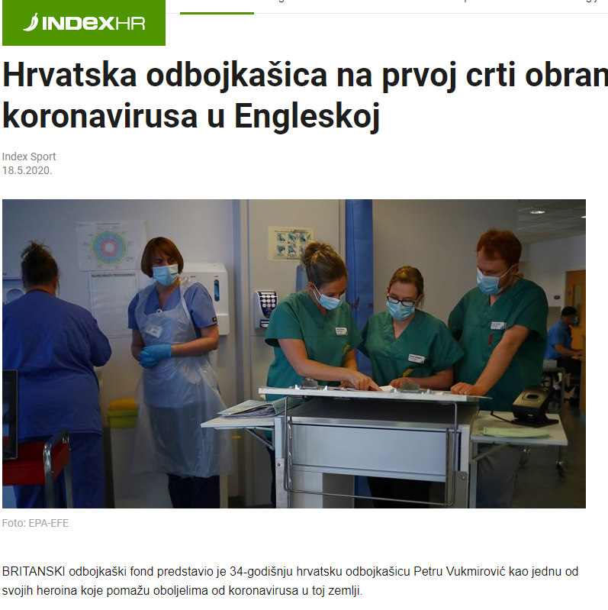
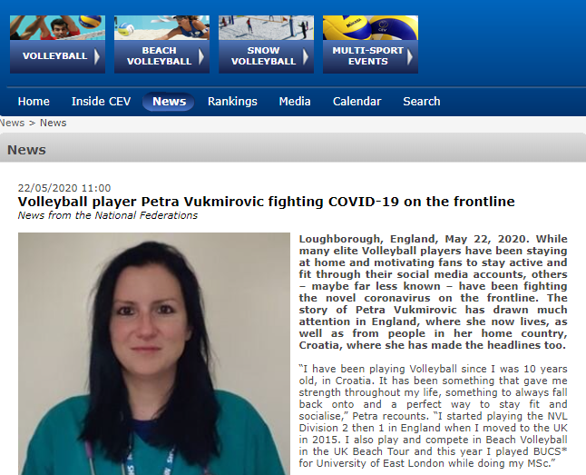
Who am i?
COVID-19 Frontline Fighter
European Confederation Article
Volleyball England Article
Index.hr Article
Notes:
Recently went viral – VE, then CEV, then Index.hr and Novi List

Slide 4
Check out the options for mapping
https://mapscript.org/ide/
https://onlinewardleymaps.com/
Using the provided ppt Template
Mapping Challenges (sorted by difficulty):
Vegetarian Burrito
Plastic pollution
2020 Lockdown
Notes:
Initially toward the end but decided to put it now as ppl can multitask

Slide 5
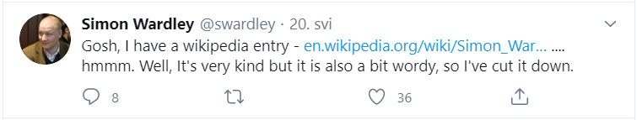
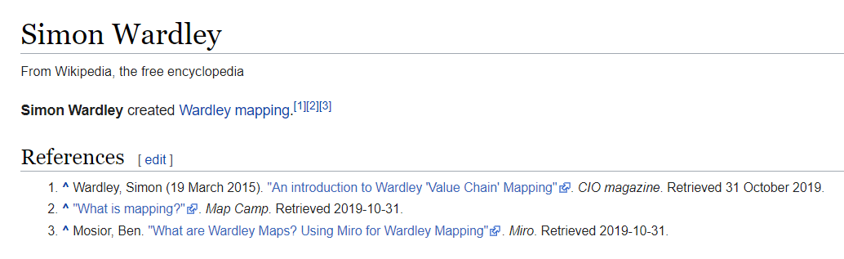
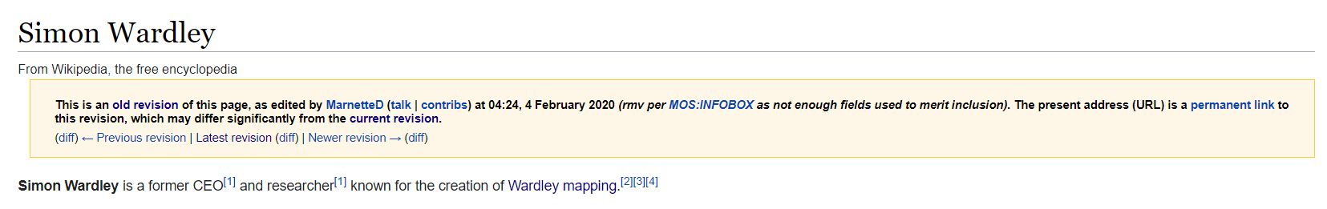
Who is Simon wardley?
Notes:
Well definitely someone with a good sarcastic sense of humour
I really laughed at this typically British sense of humour and it Reminded me of black adder that I used to watch as a teenager….

Slide 6
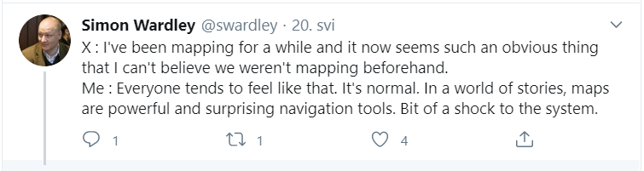
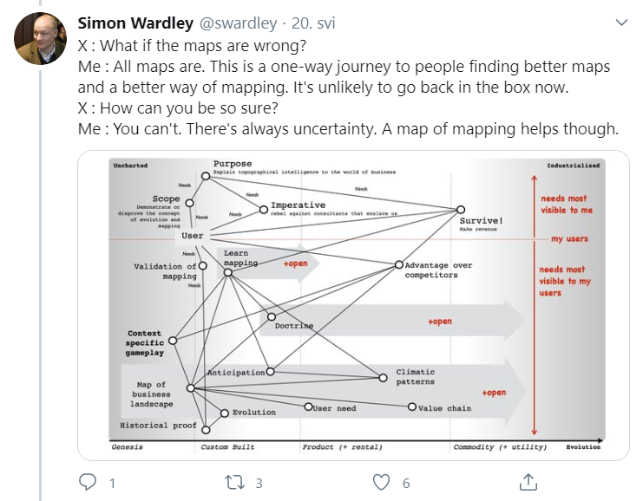
Now Really, who is he?
Originally a geneticist
An IT strategist
Former CEO
Business and Innovation Researcher
Creator of Wardley Maps (just to state the obvious)
For more, check out his Twitter @SWardley
Notes:
As Simon likes to keep it brief, I will keep it brief too
And I will let his twitter and maps speak for him

Slide 7

Why?
The key word is awareness
Awareness of what?
Your destination
The topography
Your path/route
Situational Awareness!
Why a map not a graph?
To avoid getting lost and going down circular paths knowing your landscape matters!
Notes:
if you google wardley maps you will find a lot of what but no why
To conclude: If you are lost in the vast jungle of the business world or DevOps you need to be aware of your path, your geoposition and your topography to form a strategy

Slide 8
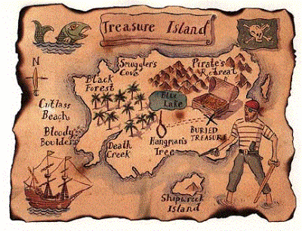
Graph vs map
N
The story of an unlucky pirate
C
Na
C
Na
N
Notes:
Let me tell you a story of an unlucky pirate
On the left side you have a treasure map and on the right hand side you have a graphical representation of sodium cyanide – a poison present in the Death Creek water
So - One pirate found a treasure map and located the treasure – but to be mean and vicious – as pirates are – he tweaked it and drawn the treasure next to the Death Creek
No you see – location on a map is important, it makes a huge difference because the next pirate that has found a map has gone to the death creek and drank poison from the creek (not knowingly off course It was hot and he was thirsty)
due to the malposition of the treasure on the map
To sum it up – cyanide is still a poison, whether his N molecule points to 5 o’clock or to 11 o’clock on the graph. However the location of the treasure on the map means a difference between life and death.
Basically, if you draw your Wardley maps wrong you might die…. Just kidding.
I hope you have a clearer idea of the difference in maps and graphs now ☺

Slide 9
A little about wardley maps
The Theory
Basic elements
Sun Tzu’s Five Factors:
purpose
landscape
climate
doctrine
leadership
Must be visual
Context specific
The position of the components should be relative to an anchor
Representation of movement present
Notes:
Sun Tzu was a Chinese military strategist in ancient China - he preferred strategy to battle itself
He had a Philosophy of War called the Art of War. It is now used extensively in business.
It has the following components.
.So quoting Simon - In that model, a wise leader has a moral imperative (a what and a why), grasps the terrain (has a map), anticipates the patterns of the forces acting on the environment (climate), trains the organization in universally useful principles and makes shrewd decisions that lead to victory (leadership)

Slide 10
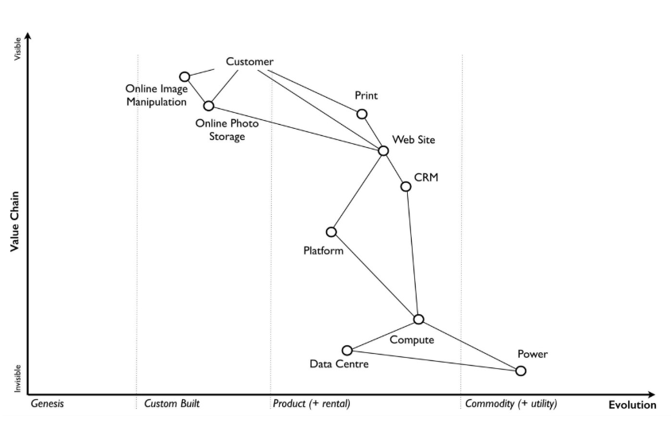
SIMON’s First map
Visual and context specific: reflects the business at a given moment of time along with the components
Anchor: the customers and their needs
The position of components in the map: higher = more visible (y-axis = value chain)
Notes:
For example, in that first map the user cares about online photo storage but whilst this needs the provision of underlying components such as compute and power, those components are positioned far from the user and hence are less visible.
Remember there is a flow flow between components - of risk, information and money.

Slide 11
X-axis: Stage of evolution
Genesis: the new and rare
Custom built: bespoke and uncommon
Product (including rental): common, well defined, manufactured through a reproduceable process
Commodity (including utility): industrialised and less visible
Left to Right: Supply and Demand
Notes:
Genesis –This represents the unique, the very rare, the uncertain, the constantly changing and the newly discovered. Our focus is on exploration.
Custom Built - This represents the very uncommon and that which we are still learning about. It is individually made and tailored for a specific environment. It is bespoke. It frequently changes. It is an artisan skill. You wouldn’t expect to see two of these that are the same. Our focus is on learning and our craft.
Product the manufactured through a repeatable process, the more defined, the better understood. Change becomes slower here. Whilst there exists differentiation particularly in the early stages there is increasing stability and sameness. You will often see many of the same product. Our focus is on refining and improving.
This represents scale and volume operations of production, the highly standardised, the defined, the fixed, the undifferentiated, the fit for a specific known purpose and repetition, repetition and more repetition. Our focus is on ruthless removal of deviation, on industrialisation, and operational efficiency. With time we become habituated to the act, it is increasingly less visible and we often forget it’s even there.

Slide 12

Stage | I | II | III | IV
Activities | Genesis | Custom | Product/rental | Commodity + utility
Practices | Novel | Emerging | Good | Modelled
Data | Unmodelled | Divergent | Convergent | Modelled
Knowledge | Concept | Hypothesis | Theory | Accepted
Notes:
Types of componenets

Slide 13
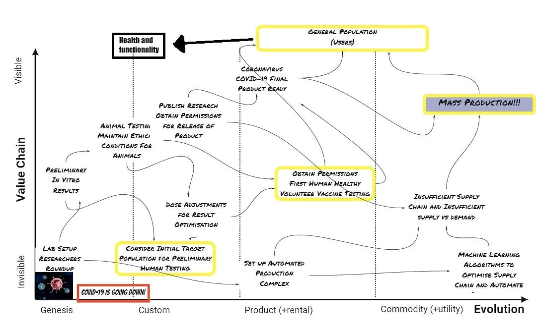
My first map
Visual – Yes
Context – Yes
Position – Yes
Anchor – Yes
Movement – Yes
Components - Yes
Anchor
Position
Notes:
This map is very imperfect but it has some basic elements
Visual……
At the genesis – the unique researchers set up in this unique situation/climate of 2020
At the end of evolution we have mass production which is visible and the use of established ML algorithms for supply chain optimisation and automation

Slide 14
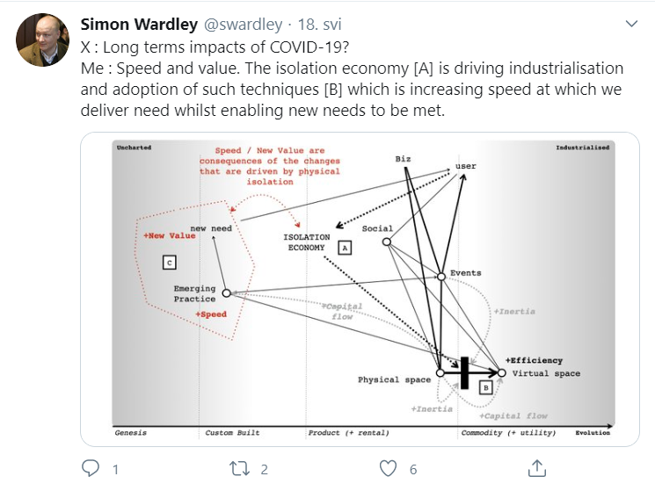

Slide 15
So how to make a map?
Identify the Users
Identify the Needs to be met
Identify the Capabilities
Determine the stage of Evolution for each
Value Chain

Slide 16
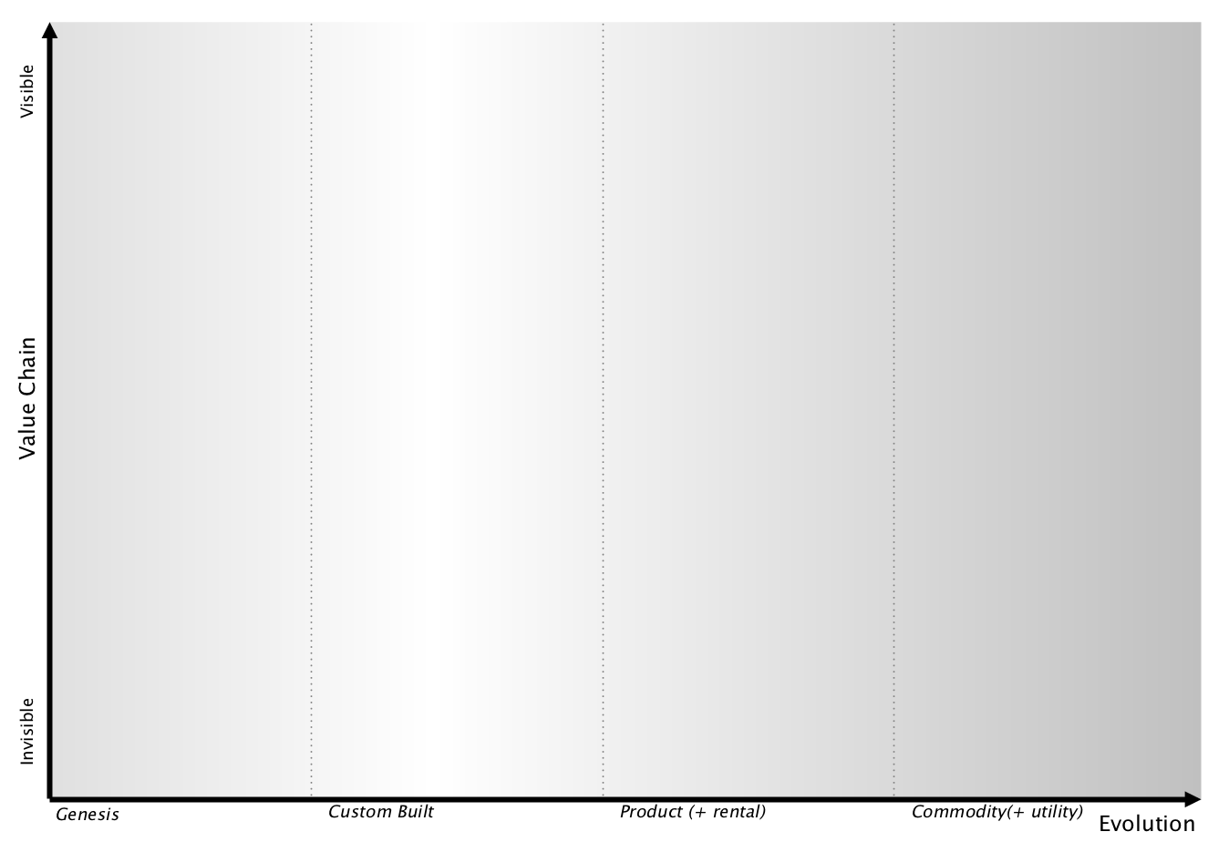
Lets get down to mapping

Slide 17
prerequisites
Please open the ppt shared in the chat
You will need Python, Ruby and C# skills for this
Maybe not – only Office Power Point skills and an imagination
Start mapping as we go along – all the components and the canvas are there

Slide 18
Users
Need #1
Need #3
Need #2
Component #1
Component #3
Needs
Component #2
Component #4
What are the components needed?
How visible are they to the user?
Map the componenet – needs – component relationships

Slide 19
Users
Need #1
Need #3
Need #2
Component #1
Component #3
Compute
Needs
Component #2
SaaS Platform
Component #4
Electricity
Add evolution to the components
How complex is each component?
A product or utility?

Slide 20
Users
Need #1
Need #3
Need #2
Component #1
Component #2
SaaS Platform
Component #3
Compute
Connect the dots!
Component #4
Electricity

Slide 21
What is next?
Read Simon’s Medium Article Finding A Path
Start Mapping More Advanced Maps on https://onlinewardleymaps.com/
Check out more techy ways to do the maps
Try Miro – tutorial and canvas (more techy than doing it in ppt)
Please share your maps in the channel #oss-2020-wardley-maps-sharepoint
Try this easy and simple tutorial by https://learnwardleymapping.com/

Slide 22
Done?
Please share your screen to show your maps!
How exciting ☺

Slide 23
Any Questions? Thank You for Your Attention!
Dr Petra Vukmirovic
Glasswall InfoSec Team

Slide 24
Photo credits and references
Wikipedia 2020, Simon Wardley (accessed at https://en.wikipedia.org/wiki/Simon_Wardley)
S. Wardley 2016., On Being Lost (accessed at https://medium.com/wardleymaps/on-being-lost-2ef5f05eb1ec)
S. Wardley 2016., Finding a Path (accessed at https://medium.com/wardleymaps/finding-a-path-cdb1249078c0)
LWM, Landscape (accessed at https://learnwardleymapping.com/home/landscape/)
This Photo by Unknown Author is licensed under CC BY

